Slide 1
According to the Law of Conservation of Energy, energy is never created or destroyed, it just changes its form.
Demonstration of the Law of Conservation of Energy: Exploratorium: Science of Baseball – “Baseketball a Physicist Party Trick”

Slide 2
Examples of Transforming Heat (Thermal) Energy
When an object is heated to a high temperature, it glows and gives off heat. Therefore, some thermal energy is converted to light (radiant) energy
A fire or a flame converts heat (thermal) energy to light (radiant) energy
Energy in the form of heat is almost always one of the products of an energy transformation.
For example, when people exercise, when cars run, when a light is turned on, heat is produced.

Slide 3
Examples of Transforming Chemical Energy
Inside your body, chemical energy is transformed into mechanical energy (kinetic energy)
Batteries, wood, matches, fireworks, fossil fuels, etc. are forms of chemical energy that are converted into other forms once used or burned
The matter contained in living organisms has chemical energy. When organisms die, this chemical energy is broken down and converted to other chemical compounds. In this process, thermal energy is released.

Slide 4
Examples of Transforming Light (Radiant) Energy
Plants use light (radiant) energy to make chemical energy. [remember Photosynthesis]
The chemical energy in food is then changed into another kind of chemical energy that your body can use. [remember cellular respiration]
Your body then uses that energy to give you mechanical energy [kinetic and potential energy]
Also, the light (radiant) energy converted into chemical energy in say a tree can then be changed into thermal energy when you burn the tree’s wood.

Slide 5
Examples of Transforming Electrical Energy
Every time you plug something into a wall outlet, you are using electrical energy and that electrical energy is transformed into other forms of energy
Blender: electrical energy ⇨ mechanical energy and sound energy
Hairdryer: electrical energy ⇨ mechanical energy, thermal energy, and sound energy
Alarm Clock: electrical energy ⇨ light energy and sound energy
Notes:
Electrical energy changes into thermal energy when a wire carrying an electric current gets hot

Slide 6

Let’s examine the Energy Transformation in riding a bike.
As the rider pedals, her leg muscles transform chemical energy (potential energy stored from the food she ate) into mechanical (kinetic) energy
The mechanical (kinetic) energy of her leg muscles transforms into mechanical (kinetic energy) of the bicycle as she pedals
Some of this energy transforms into potential energy as she moves up the hill
Some energy is transformed into thermal energy (her body is warmer because chemical energy is released and because of friction, the mechanical parts of the bicycle are warmer too)

Slide 7
Energy Transformations in a Car
A car engine transforms the chemical energy in gasoline into mechanical energy (kinetic and potential energy)
Not all of the chemical energy is converted into mechanical energy. Some is converted into thermal energy, and the engine becomes hot.
The chemical energy in the car battery is also transformed into other forms of energy

Slide 8
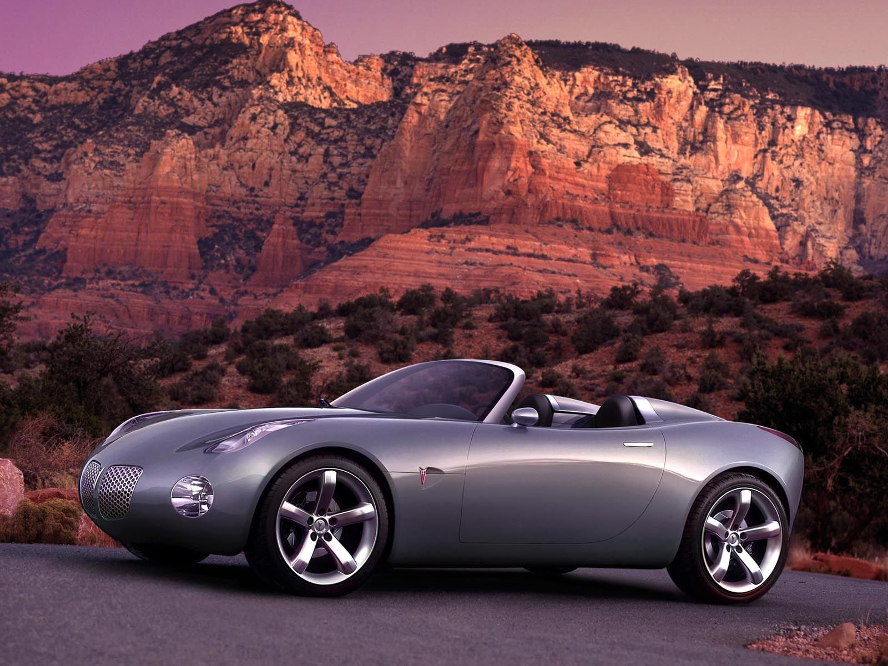

Identify other energy transformations that you can observe in a car.

Slide 9
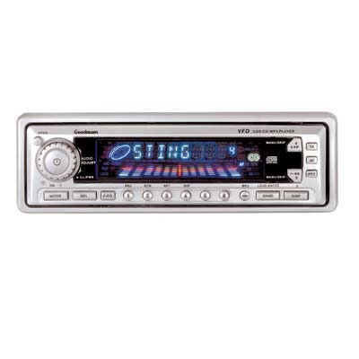

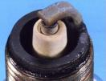
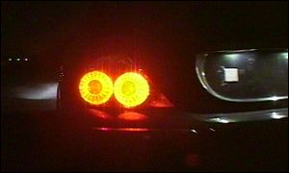
Energy Transfer
Sound
(mechanical)
Electrical
Thermal
Mechanical
Electrical
Chemical
Electrical
Light
(Electromagnetic)

Slide 10
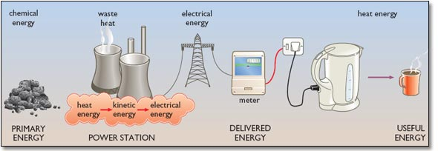
Energy Transformations

Slide 11
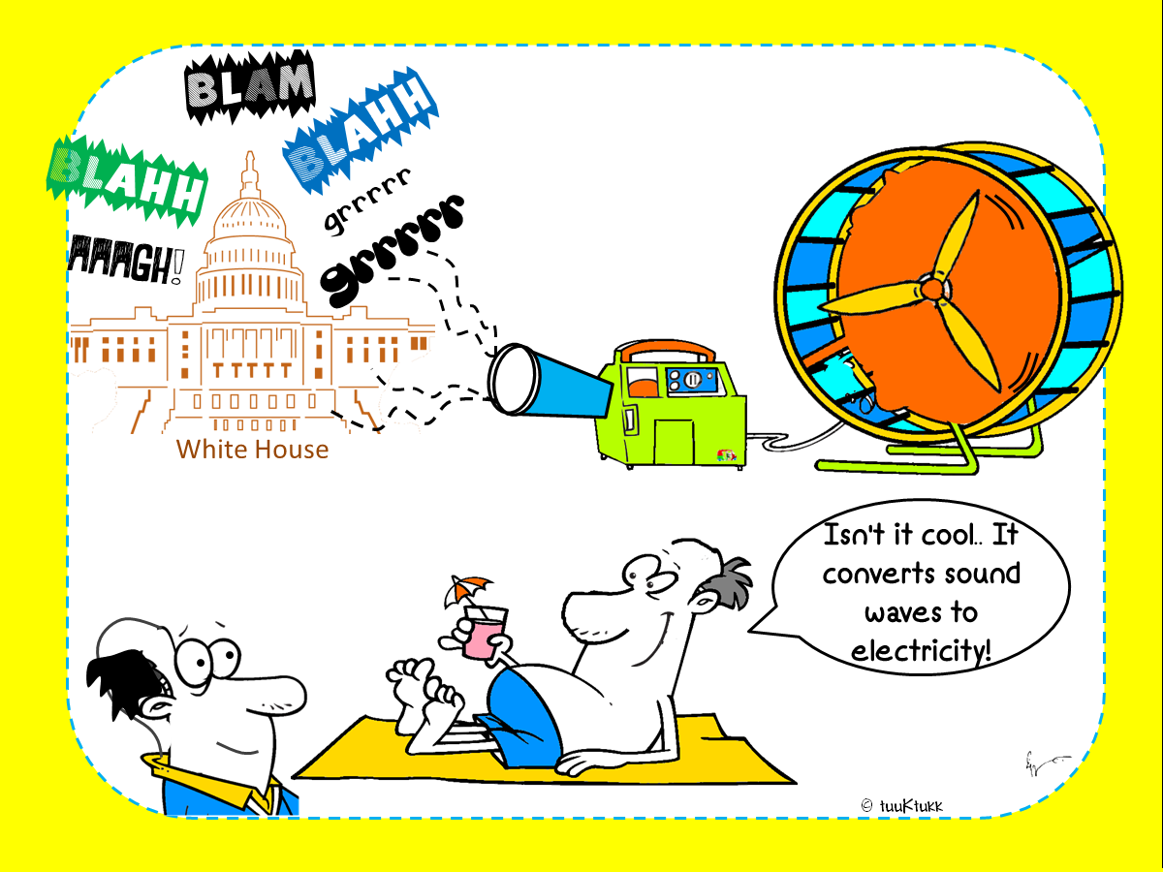

Slide 12
Watch the short video clip. Identify the energy transformations that occur.
http://www.discovery.com/tv-shows/other-shows/videos/time-warp-lighting-a-match.htm
In the video, chemical energy in the match changes to heat (thermal) energy and light (radiant) energy.
While the match is burning, is the amount of chemical energy in the match the same? Why or Why not?
As the match is burning, the chemical energy is decreasing while the thermal energy and the radiant energy are increasing.

Slide 13
Identify the Energy Transformation

Slide 14

Identify the Energy Transformation

Slide 15

Identify the Energy Transformation

Slide 16

Identify the Energy Transformation

Slide 17

Identify the Energy Transformation

Slide 18
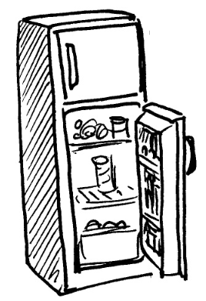
Identify the Energy Transformation

Slide 19

Identify the Energy Transformation

Slide 20

Identify the Energy Transformation

Slide 21

Identify the Energy Transformation

Slide 22

Identify the Energy Transformation

Slide 23

Identify the Energy Transformation

Slide 24
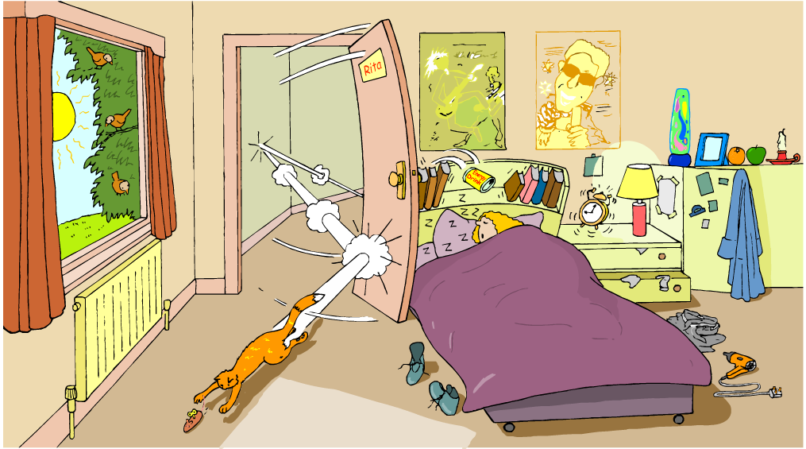
Identify energy transformations in the illustration below. Include the following: Heat, Light, Mechanical, Electrical, Sound, & Chemical

